Slide 1







Welcomes
12 programmes accredited
Ranked 501-600 in Rankings 2025
Ranked 801-850 in
World Rankings 2025
Ranked 46th in
Rankings 2024*
A Grade
* University Category

Slide 2
Computer Organization | Instruction Formats (Zero, One, Two and Three Address Instruction)

Slide 3
Different Types of Instruction Fields
A computer performs a task based on the instructions provided. Instructions in computers are comprised of groups called fields. These fields contain different information for computers which are all written in 0s and 1s. Each field has a different significance or meaning, based on which a CPU decides what to perform. The most common fields are:
The operation field specifies the operation to be performed, like addition.
Address field which contains the location of the operand, i.e., register or memory location.
Mode field which specifies how operand is to be founded.

Slide 4
Instruction and CPU Organization
A computer performs a task based on the instructions provided. Instructions in computers are comprised of groups called fields. These fields contain different information for computers which are all written in 0s and 1s. Each field has a different significance or meaning, based on which a CPU decides what to perform. The most common fields are:
The operation field specifies the operation to be performed, like addition.
Address field which contains the location of the operand, i.e., register or memory location.
Mode field which specifies how operand is to be founded.

Slide 5
Types of Instructions
Zero Address Instructions
These instructions do not specify any operands or addresses. Instead, they operate on data stored in registers or memory locations implicitly defined by the instruction. For example, a zero-address instruction might simply add the contents of two registers together without specifying the register names.
Zero Address Instruction
A stack-based computer does not use the address field in the instruction. To evaluate an expression, it is first converted to reverse Polish Notation i.e. Postfix Notation.
Expression: X = (A+B)*(C+D) Postfixed : X = AB+CD+* TOP means top of stack M[X] is any memory location

Slide 6
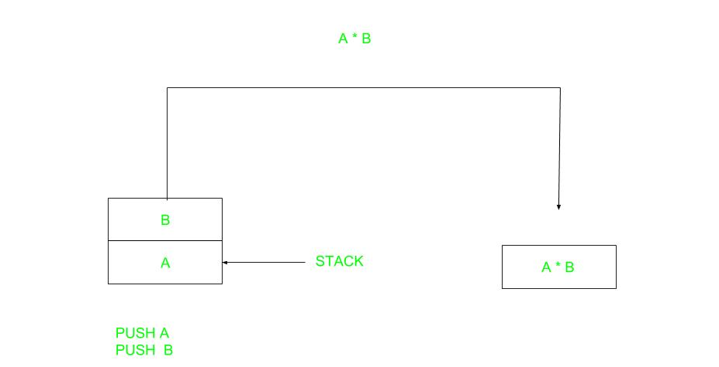

Slide 7
Operation | Instruction | Stack (TOP Value After Execution)
Push A | PUSH A | TOP = A
Push B | PUSH B | TOP = B
Add | ADD | TOP = A + B
Push C | PUSH C | TOP = C
Push D | PUSH D | TOP = D
Add | ADD | TOP = C + D
Multiply | MUL | TOP = (C + D) * (A + B)
Pop X | POP X | M[X] = TOP

Slide 8

One Address Instructions
These instructions specify one operand or address, which typically refers to a memory location or register. The instruction operates on the contents of that operand, and the result may be stored in the same or a different location. For example, a one-address instruction might load the contents of a memory location into a register.
This uses an implied ACCUMULATOR register for data manipulation. One operand is in the accumulator and the other is in the register or memory location. Implied means that the CPU already knows that one operand is in the accumulator so there is no need to specify it.

Slide 9
One Address Instruction
Expression: X = (A+B)*(C+D) AC is accumulator M[] is any memory location M[T] is temporary location

Slide 10
Operation | Instruction | Stack / Register (AC / M[])
Load A | AC = A | AC = A
Add B | AC = AC + B | AC = A + B
Store M[T] | M[T] = AC | M[T] = A + B
Load C | AC = C | AC = C
Add D | AC = AC + D | AC = C + D
Store M[] | M[] = AC | M[] = C + D
Multiply M[T] | AC = AC * M[T] | AC = (A + B) * (C + D)
Store X | M[X] = AC | M[X] = (A + B) * (C + D)

Slide 11
Two Address Instructions
These instructions specify two operands or addresses, which may be memory locations or registers. The instruction operates on the contents of both operands, and the result may be stored in the same or a different location. For example, a two-address instruction might add the contents of two registers together and store the result in one of the registers.
This is common in commercial computers. Here two addresses can be specified in the instruction. Unlike earlier in one address instruction, the result was stored in the accumulator, here the result can be stored at different locations rather than just accumulators, but require more number of bit to represent the address.

Slide 12
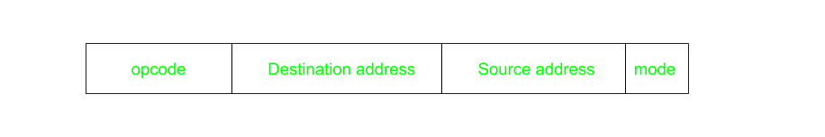
Two Address Instruction
Here destination address can also contain an operand.
Expression: X = (A+B)*(C+D) R1, R2 are registers M[] is any memory location

Slide 13
Operation | Instruction | Registers / Memory (R1, R2, M[])
Load A | R1 = A | R1 = A
Add B | R1 = R1 + B | R1 = A + B
Store M[T] | M[T] = R1 | M[T] = A + B
Load C | R2 = C | R2 = C
Add D | R2 = R2 + D | R2 = C + D
Store M[] | M[] = R2 | M[] = C + D
Multiply M[T] | R1 = R1 * M[T] | R1 = (A + B) * (C + D)
Store X | M[X] = R1 | M[X] = (A + B) * (C + D)

Slide 14
Three Address Instructions
These instructions specify three operands or addresses, which may be memory locations or registers. The instruction operates on the contents of all three operands, and the result may be stored in the same or a different location.
For example, a three-address instruction might multiply the contents of two registers together and add the contents of a third register, storing the result in a fourth register.
This has three address fields to specify a register or a memory location. Programs created are much short in size but number of bits per instruction increases.
These instructions make the creation of the program much easier but it does not mean that program will run much faster because now instructions only contain more information but each micro-operation (changing the content of the register, loading address in the address bus etc.) will be performed in one cycle only.

Slide 15
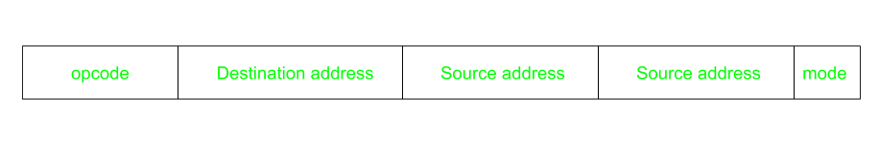
Three Address Instruction
Expression: X = (A+B)*(C+D) R1, R2 are registers M[] is any memory location

Slide 16
Operation | Instruction | Registers / Memory (R1, R2, M[])
Load A | R1 = A | R1 = A
Add B | R1 = R1 + B | R1 = A + B
Store M[T] | M[T] = R1 | M[T] = A + B
Load C | R2 = C | R2 = C
Add D | R2 = R2 + D | R2 = C + D
Store M[] | M[] = R2 | M[] = C + D
Multiply M[T] | R1 = R1 * M[T] | R1 = (A + B) * (C + D)
Store X | M[X] = R1 | M[X] = (A + B) * (C + D)

Slide 17
Advantages and Dis-advantages of Zero-Address, One-Address, Two-Address and Three-Address Instructions
Zero-address instructions (advantage)
Stack-based Operations: In stack-based architectures, where operations implicitly employ the top items of the stack, zero-address instructions are commonly used.
Reduced Instruction Set: It reduces the complexity of the CPU design by streamlining the instruction set, which may boost reliability.
Less Decoding Complexity: Especially helpful for recursive or nested processes, which are frequently used in function calls and mathematical computations.
Efficient in Nested Operations: Less bits are required to specify operands, which simplifies the logic involved in decoding instructions.
Compiler Optimization: Because stacks are based on stacks, several algorithms can take use of this to improve the order of operations.

Slide 18
Zero-address instructions (Disadvantages)
Stack Dependency: In contrast to register-based architectures, zero-address instructions might result in inefficiencies when it comes to operand access because of their heavy reliance on the stack.
Overhead of Stack Operations: Performance might be negatively impacted by the frequent push and pop actions needed to maintain the stack.
Limited Addressing Capability: The processing of intricate data structures may become more difficult since they do not directly support accessing memory regions or registers.
Difficult to Optimize: Because operand access is implied in stack-based designs, code optimization might be more difficult.
Harder to Debug: When compared to register-based operations, stack-based operations might be less obvious and more difficult to debug.

Slide 19
One-address instructions (advantages)
Intermediate Complexity: Strikes a balance between versatility and simplicity, making it more adaptable than zero-address instructions yet simpler to implement than multi-address instructions.
Reduced Operand Handling: Compared to multi-address instructions, operand fetching is made simpler by just needing to handle a single explicit operand.
Implicit Accumulator: O ften makes use of an implicit accumulator register, which can expedite up some operations’ execution and simplify designs in other situations.
Code Density: S maller code in comparison to two- and three-address instructions, which may result in more efficient use of memory and the instruction cache.
Efficient Use of Addressing Modes: Can make use of different addressing modes (such indexed, direct, and indirect) to improve flexibility without adding a lot of complexity.

Slide 20
One-address instructions (disadvantages)
Accumulator Bottleneck: Often uses an accumulator, which can act as a bottleneck and reduce efficiency and parallelism.
Increased Instruction Count: Multiple instructions may be needed for complex processes, which would increase the overall number of instructions and code size.
Less Efficient Operand Access: There is just one operand that is specifically addressed, which might result in inefficient access patterns and extra data management instructions.
Complex Addressing Modes: The instruction set and decoding procedure get more complicated when several addressing modes are supported.
Data Movement Overhead: Moving data between memory and the accumulator could need more instructions, which would increase overhead.

Slide 21
Two-address instructions
Improved Efficiency: Allows for the execution of operations directly on memory or registers, which reduces the amount of instructions required for certain activities.
Flexible Operand Use: Increases programming variety by offering more options for operand selection and addressing modes.
Intermediate Data Storage: May directly store interim results, increasing some algorithms’ and calculations’ efficiency.
Enhanced Code Readability: Produces code that is frequently easier to read and comprehend than one-address instructions, which is beneficial for maintenance and troubleshooting.
Better Performance: Better overall performance can result from these instructions because they minimize the amount of memory accesses required for certain processes.

Slide 22
Two-address instructions (Disadvantages)
Operand Overwriting: Usually, the result overwrites one of the source operands, which might lead to an increase in the number of instructions needed to maintain data.
Larger Instruction Size: Because two-address instructions are bigger than zero- and one-address instructions, the memory footprint may be increased.
Intermediate Results Handling: It is frequently necessary to handle intermediate outcomes carefully, which can make programming more difficult and result in inefficiencies.
Decoding Complexity: The design and performance of the CPU may be impacted by the greater complexity involved in decoding two addresses.
Inefficient for Some Operations: The two-address style could still be inefficient for some tasks, needing more instructions to get the desired outcome.

Slide 23
Three-address instructions (advantages)
Direct Representation of Expressions: Reduces the need for temporary variables and extra instructions by enabling the direct representation of complicated expressions.
Parallelism: Allows for the simultaneous fetching and processing of several operands, which facilitates parallelism in CPU architecture.
Compiler Optimization: Makes it possible for more complex compiler optimizations to be implemented, which improve execution efficiency by scheduling and reordering instructions.
Reduced Instruction Count: May increase execution performance even with bigger instruction sizes by perhaps lowering the overall number of instructions required for complicated processes.
Improved Pipeline Utilization: More information in each instruction allows CPU pipelines to be used more efficiently, increasing throughput overall.
Better Register Allocation: Permits direct manipulation of several registers inside a single instruction, enabling more effective usage of registers.

Slide 24
Three-address instructions (Disadvanges)
Largest Instruction Size: Has the highest memory requirements per instruction, which can put strain on the instruction cache and increase code size.
Complex Instruction Decoding: Three addresses to decode adds complexity to the CPU architecture, which might affect power consumption and performance.
Increased Operand Fetch Time: Each instruction may execute more slowly if obtaining three operands takes a long period.
Higher Hardware Requirements: Has the potential to raise cost and power consumption since it requires more advanced hardware to handle the higher operand handling and addressing capabilities.
Power Consumption: Higher power consumption is a crucial factor for devices that run on batteries since it can be caused by more complicated instructions and increased memory utilization.

